Slide 1
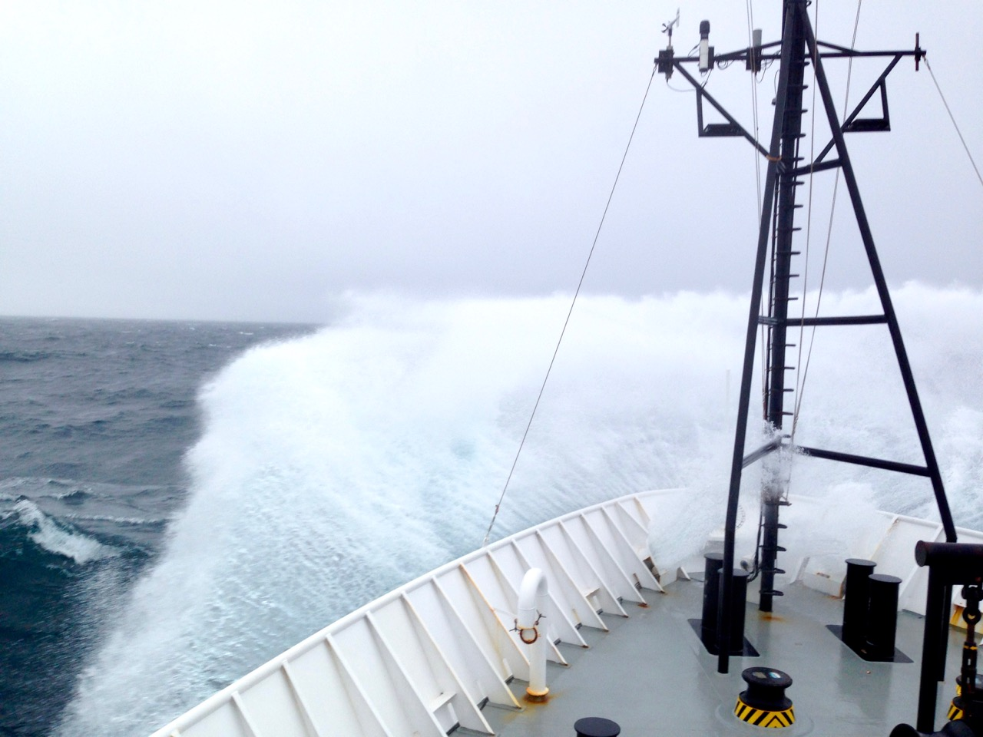
¹⁴C in the Oceans
Brett Walker, UC Irvine AMS Short Course 2017

Slide 2
Outline
• Why is the surface ocean several hundred ¹⁴C years old?
• Controls on oceanic ¹⁴C
• Corals as diaries of ocean mixing and climate
• Mixing time of the deep ocean conveyor
• Why is dissolved organic carbon (DOC) so old?
• ¹⁴C in particles and Black Carbon

Slide 3
Marine Carbon Reservoirs
DIC: Dissolved Inorganic C (< 1µm) 38,100 GtC
DOC: Dissolved Organic C (< 0.2 µm) 662 GtC
POC: Particulate Organic C (> 0.2 µm) 25 GtC
BC: Black C (< 0.2 µm) >14 GtC
SOC: Sedimentary OC 0–1m 150 GtC

Slide 4
Why does the ocean contain so much DIC? (38,000 GtC)
CO₂ hydrates to H₂CO₃
CO_{2(gas)} + H₂O <---> H₂CO₃
H₂CO₃ (0.5%) <---> H⁺ + HCO₃⁻ (89%)
HCO₃⁻ <---> H⁺ + CO₃²⁻ ⁼ (10.5%)

Slide 5
Gas Exchange of CO₂ Between Surface Ocean and Atmosphere (per 1 m²)
Air
CO₂
~20 mol/m²/y
Turnover = 200 mol/m² = 10 y
Time 20 mol/m²/y
Surface Ocean 0-100m
DIC =
200 mol/m²
But ¹⁴C age of surface ocean is 300-600 ¹⁴C y. Why?

Slide 6
‘Reservoir Age’ of Non-Polar Surface DIC
F
∆
¹⁴C age
1.0
0‰
0 ¹⁴C y
Air
CO₂
20 mol/m²/y
.93-.96
-70 to
-40‰
580-330 ¹⁴C y
Surface Ocean
• Mixing of deeper, older waters into the surface
is much larger than gas exchange.
• So ¹⁴C is a water mass tracer, not a tracer of air–sea gas exchange.
[DIC] =200 mol/m²
>>20 mol/m²/y
.92-.95
-80 to
-50‰
670-410 ¹⁴C y
Subsurface Ocean

Slide 7
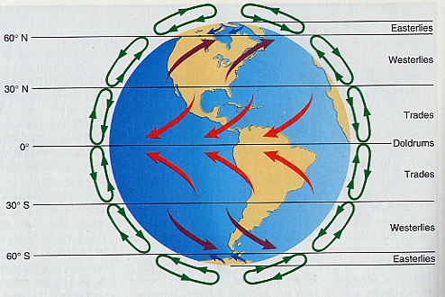
Major control on ¹⁴C in the surface ocean… The Winds

Slide 8
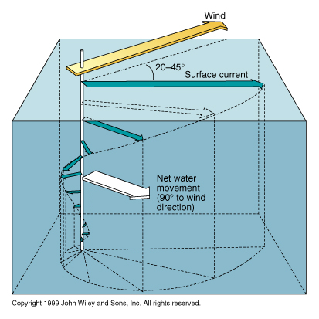
And the Coriolis Force –> Ekman Transport
Force
In mid-gyre:
Surface
∆ = -50‰
Subsurface
∆ = -60‰
Motion
…In Northern
Hemisphere,
net motion of
water is to the
right of force

Slide 9
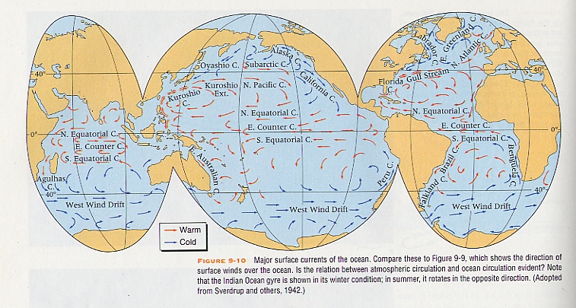
Surface currents and pre-bomb ∆
-40 to -50‰
-55 to -65‰
-72‰
-40 to -50‰
-100 to -160‰
= Mid-ocean gyre
Notes:
How did we get these ∆ values?

Slide 10
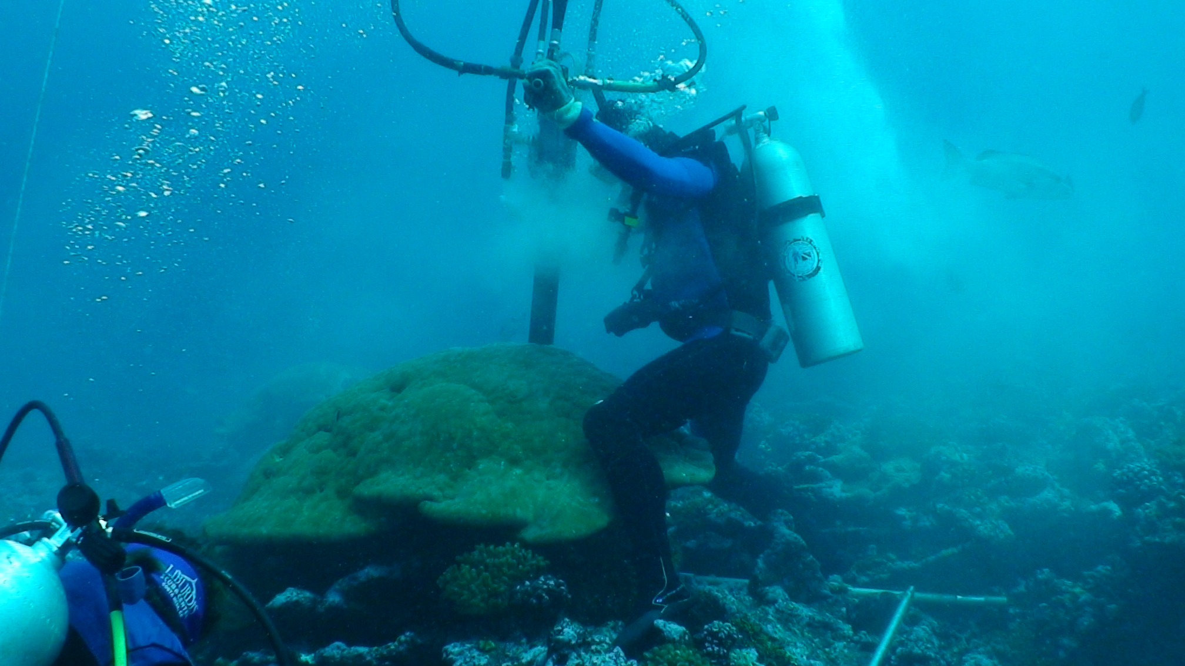
Tales of past surface circulation + climate from corals
We assume:
∆_{coral} = ∆¹⁴C_{DIC in seawater}
Notes:
• Shows removal of core from barrel
• Cores up to 8 m long
• Coral accretes aragonite with same isotope ratios as in seawater, or with the same fractionation offset, so seawater records of SST and 14C can be reconstructed.

Slide 11
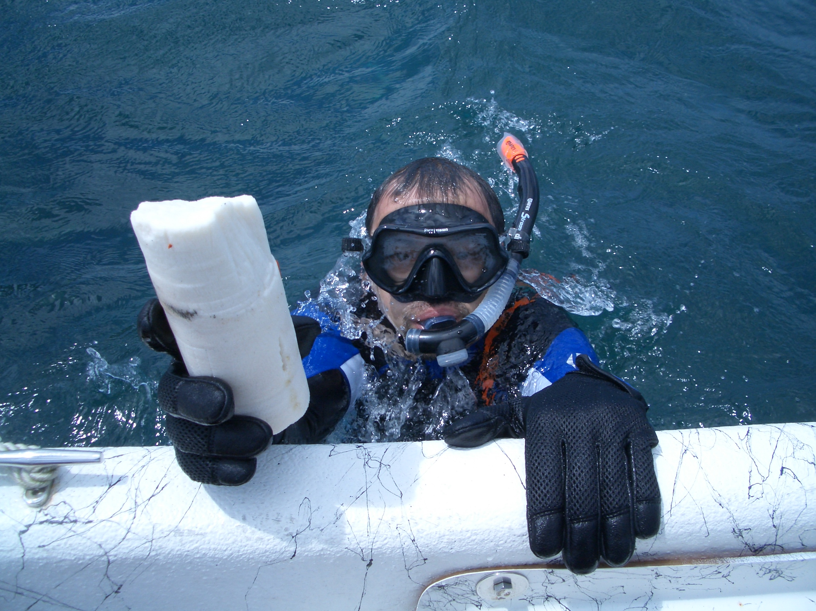
Delivery of coral core to boat, and sealing the hole in coral

Slide 12
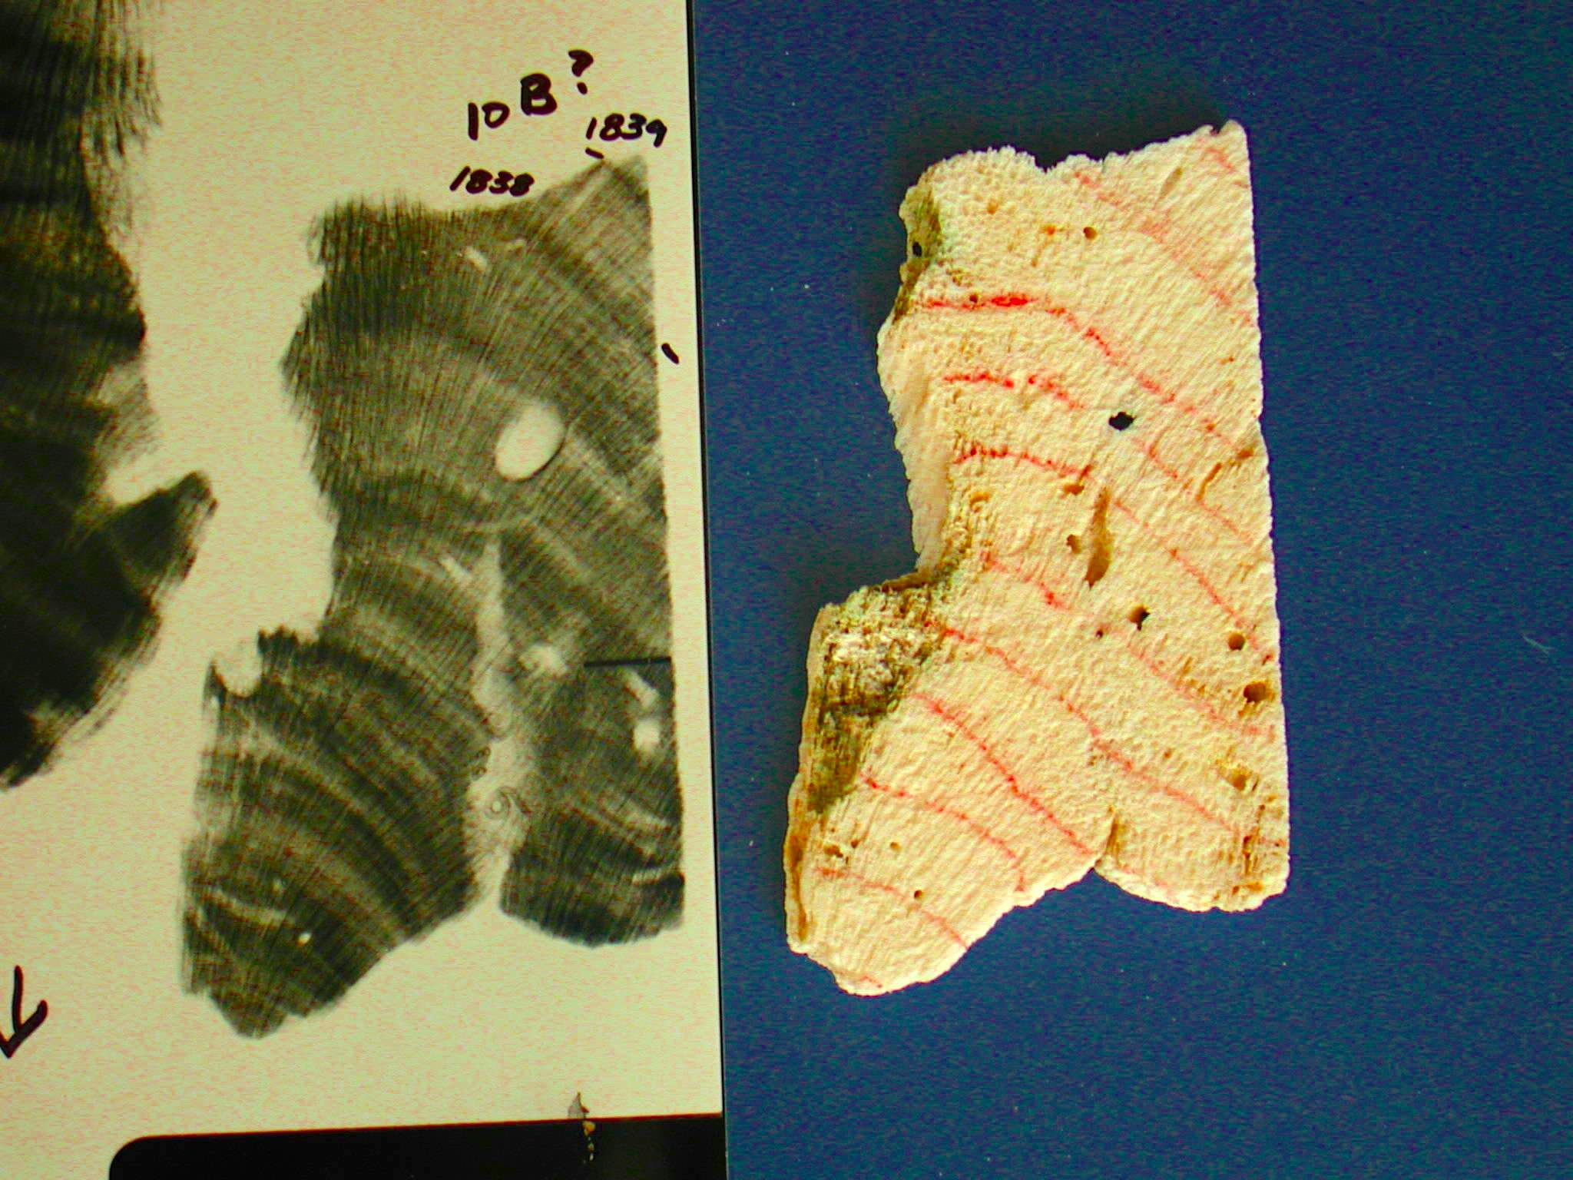
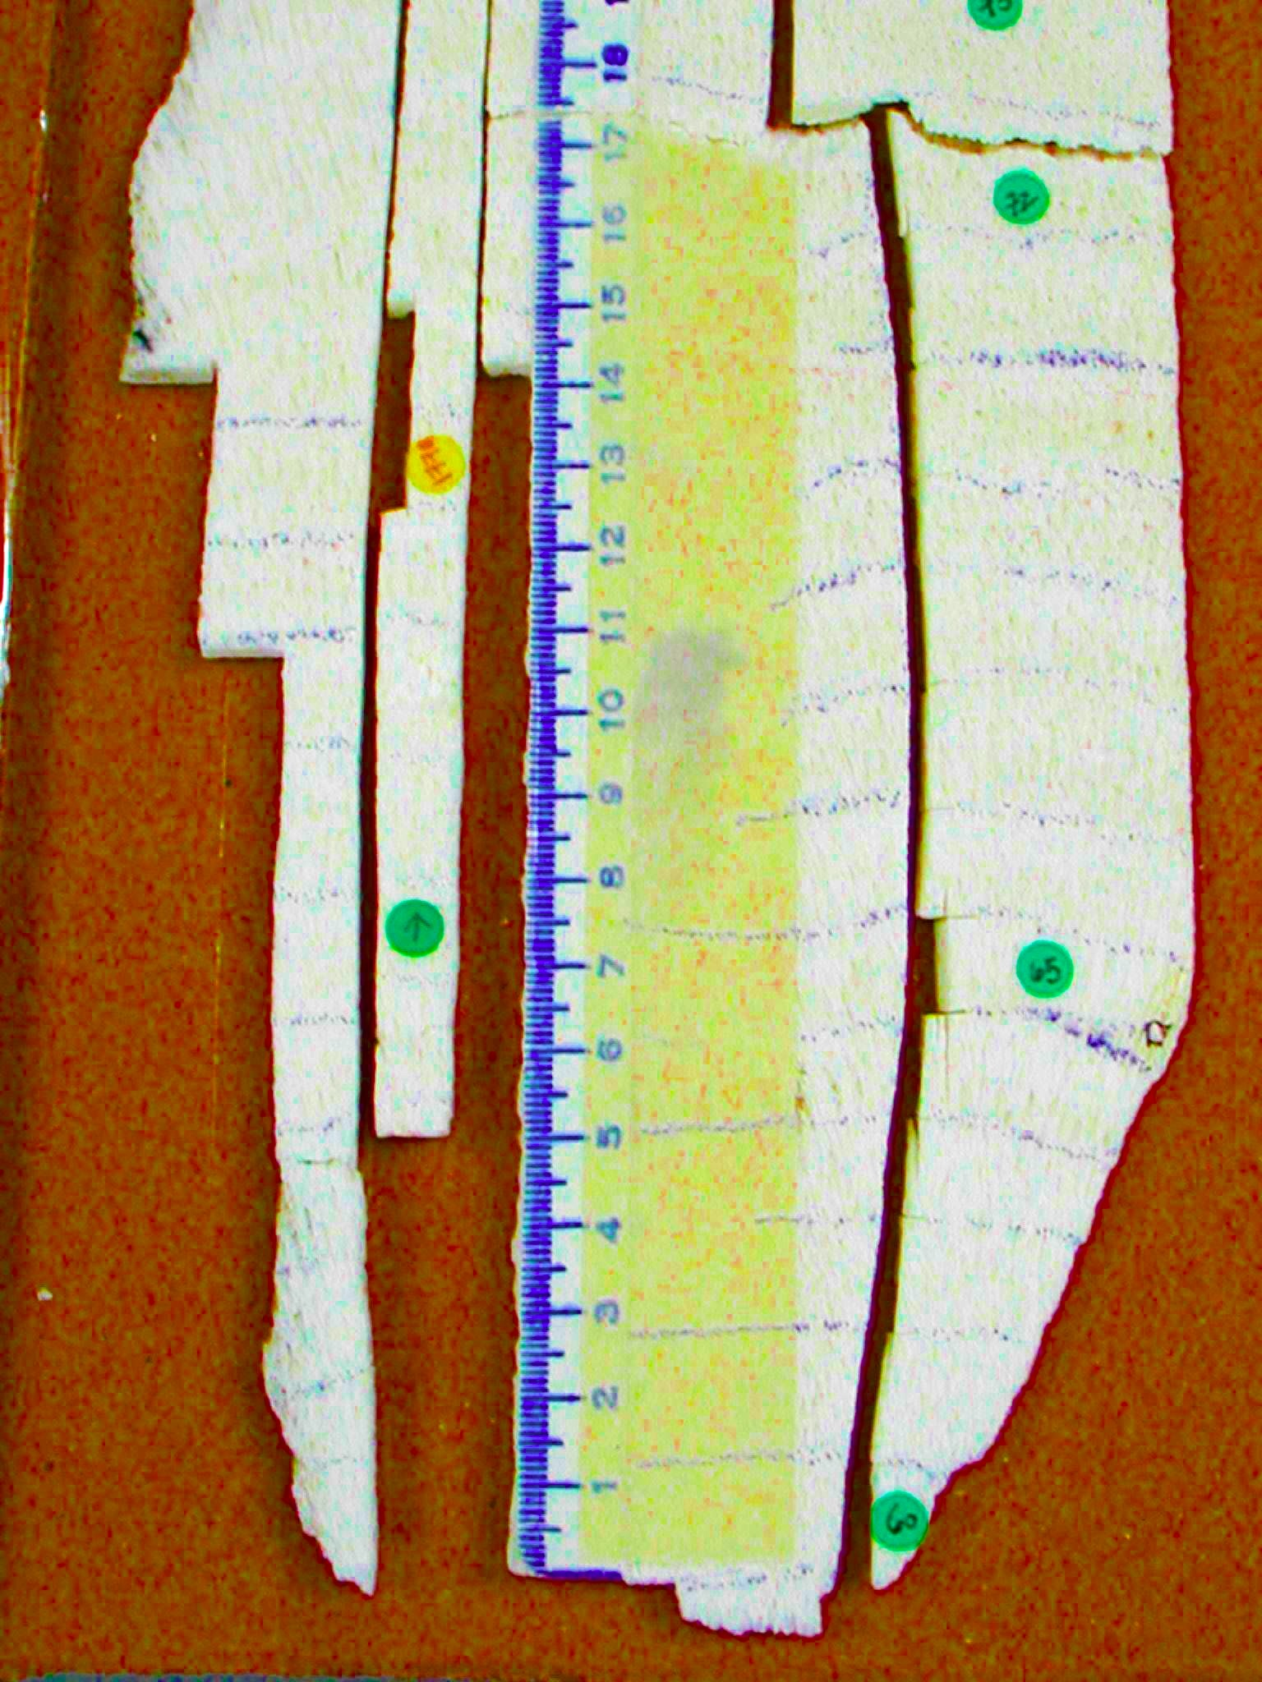
Sectioning of Coral Cores
Mapped
Slab
core
slab
X-ray
Sampled
using saw or
Dremel
tool
AMS analysis
Notes:
The cores are cut along the axis of upward growth.
Then x-rayed to reveal annual density bands.
Then samples are drilled along the axis of growth and a variety of chemicals and isotopes measured.

Slide 13
Δ (known-age corrected samples)
Corrected for decay of ¹⁴C in the sample from the year of growth (x) to 1950
Δ expresses the radiocarbon signature relative to “Modern” had the sample been measured in 1950. This is useful for studies attempting to show how the radiocarbon signature of air (tree rings) and water (corals) changes with time. It is the basis for creating the calibration curves used to calculate calendar age from ¹⁴C age.

Slide 14
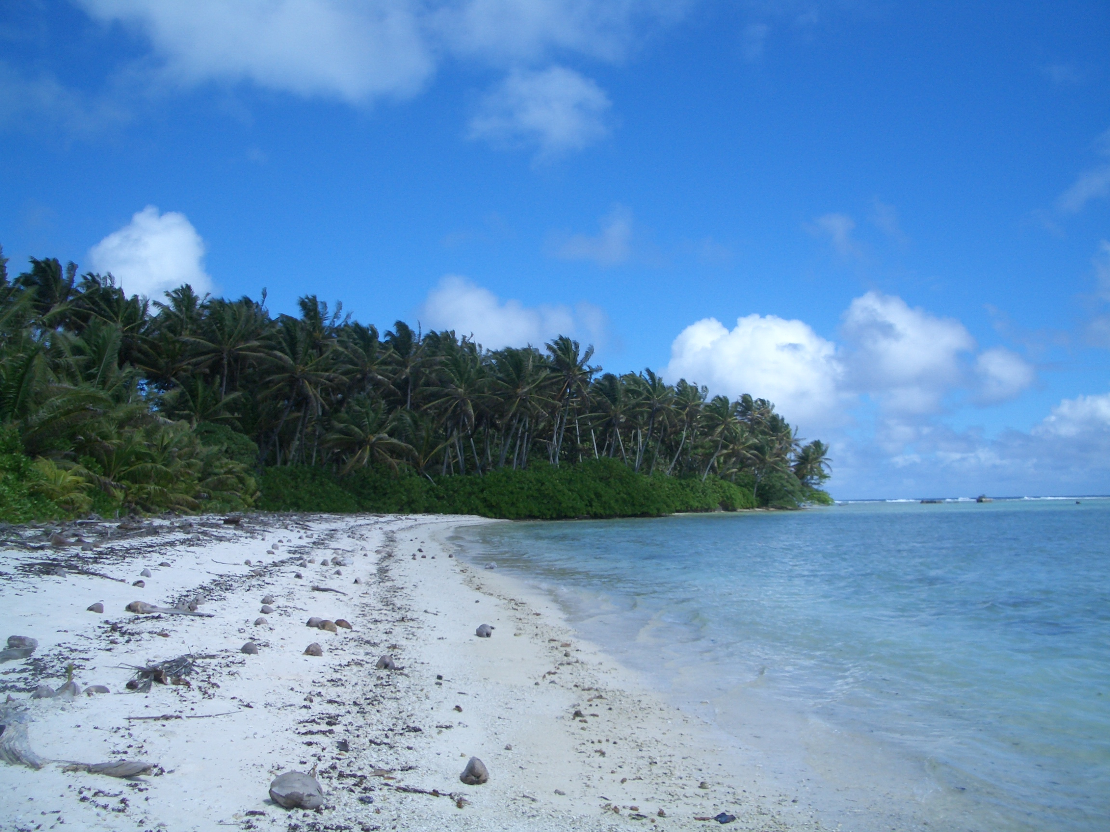
Known age correction
Check yourself
You obtain F of 0.900 for a coral that grew in Palmyra Atoll in AD 1900. What is the age corrected F value?
a) 0.9000
b) 0.8955
c) 0.9055
d) 0.9126

Slide 15
Known age correction
Check yourself
You obtain F of 0.900 for a coral that grew in Palmyra Atoll in AD 1900. What is the age corrected F value?
a) 0.9000
b) 0.8955
c) 0.9055
d) 0.9126
¹⁴C has decayed away between 1900 to 1950. Have to add ¹⁴C. ↑F
50‰ per 400yrs, or ~5‰.

Slide 16
Bomb ¹⁴C maximum in surface ocean occurs 10 y after that in air
∆
‰
Atmospheric
CO₂
Mid-ocean gyre surface
water DIC (coral)
Notes:
Bomb-14C left a tell-tale spike of high 14C in all carbon pools that have exchanged C with this atmospheric C since then. (Fig)
The bomb 14C curve is shown since 1940 in the air (red) and in the ocean (blue).
The measure of 14C is “∆14C” which is the per mil deviation from that of 19th century wood.
This rise is huge, being 200‰ in the ocean and nearly double in the atmosphere. Especially when one considers that the uncertainty of a given 14C value is 3‰ (signal to noise ratio of almost 70).

Slide 17
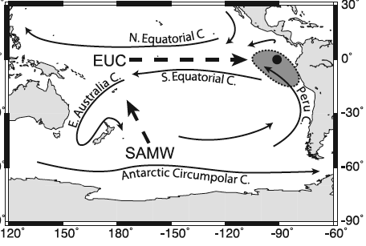
Galapagos coral ∆¹⁴C
El Niño
PDO shifted
to + phase
Guilderson and Schrag (1998)
Year
Notes:
Guilderson and Schrag reconstructed seasonal 14C in a Galapagos coral (8-12 samples/y).
Seasonal signal ranges from 20-100‰
There are increases in ∆14C during El Nino events, shown in grey
There was an increase in the wintertime low during the climate shift of 1976
So 14C is an indicator of El Ninos and longer term climate shifts (PDO)
What is the source of this low 14C water?

Slide 18
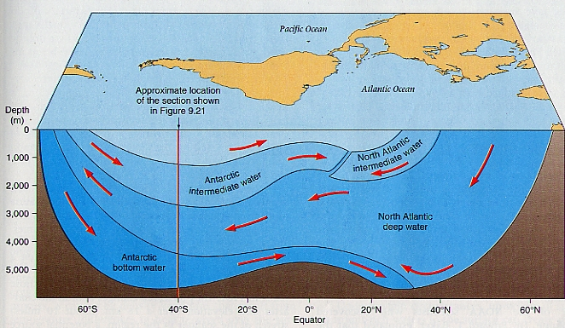
¹⁴C measurements led to our understanding of the deep circulation in the ocean by Broecker and others
North Atlantic
Deep Water
forms here
∆¹⁴C -80‰
∆¹⁴C -160‰

Slide 19
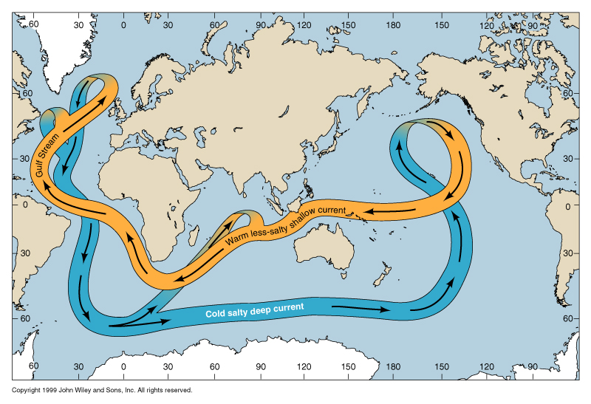
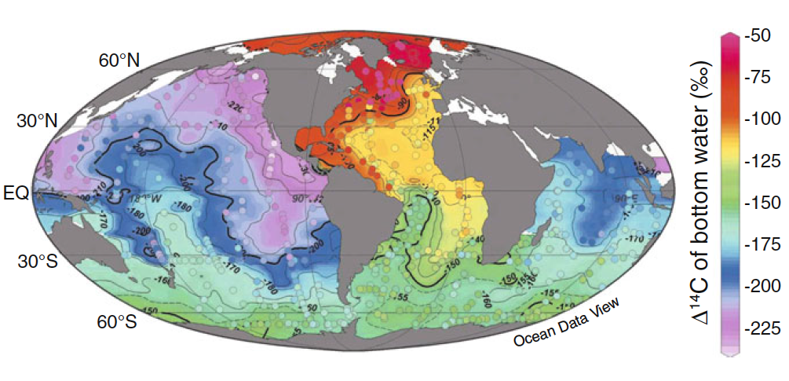
Deep DIC ∆¹⁴C
~1500 ¹⁴C y difference =
transit time of the conveyor
Conveyor
Schlitzer 2007

Slide 20
Raise 1 or 2 fingers with the right answer
Check yourself
You measure ∆¹⁴C in 3 seawater DIC samples but forget to label the samples. Values are -240‰, +30‰ and -80‰.
Where are they from?
Deep N. Atlantic, surface Pacific and deep Indian
2) Deep N. Pacific, surface Atlantic and deep Atlantic

Slide 21
Raise 1 or 2 fingers with the right answer
Check yourself
You measure ∆¹⁴C in 3 seawater DIC samples but forget to label the samples. Values are -240‰, +30‰ and -80‰.
Where are they from?
Deep N. Atlantic, surface Pacific and deep Indian
2) Deep N. Pacific, surface Atlantic and deep Atlantic

Slide 22
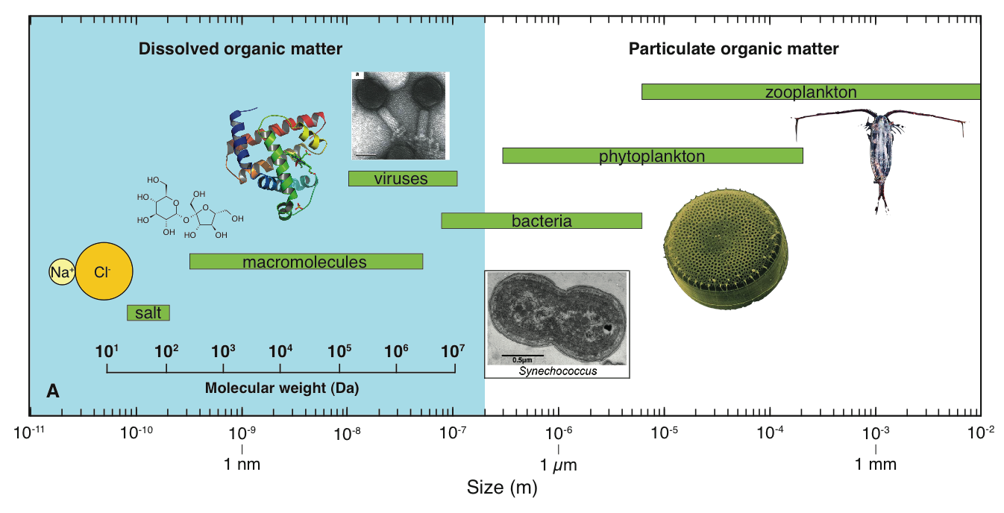
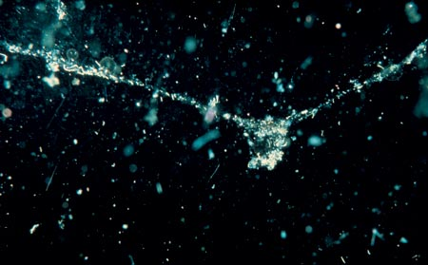
Marine Organic Matter
(Adapted from Hedges 2002, Verdugo 2004)

Slide 23
Why do we care about DOM and POM?
DOM ~662 Gt C
95% of NLOM
<10% known biomolecules
Microbial Loop: true base of food web
Bulk ¹⁴C age is very old (4,000–6,500 yrs)
But many labile components! Active role in Primary Prod.
Chelation of trace metals (micronutrients)

Slide 24

Why do we care about DOM and POM?
DOM ~662 Gt C
5% of NLOM
Biological Pump: C-export
Supports all deep ocean life
20-30% known biomolecules
Water column recorded in sediments
POM ~25 Gt C NON LIVING

Slide 25

Why do we care about DOM and POM?
DOM ~662 Gt C
POM ~25 Gt C NON LIVING
Living OM ~2 Gt C
Knowing sources and dynamics = understanding all OM in the ocean

Slide 26
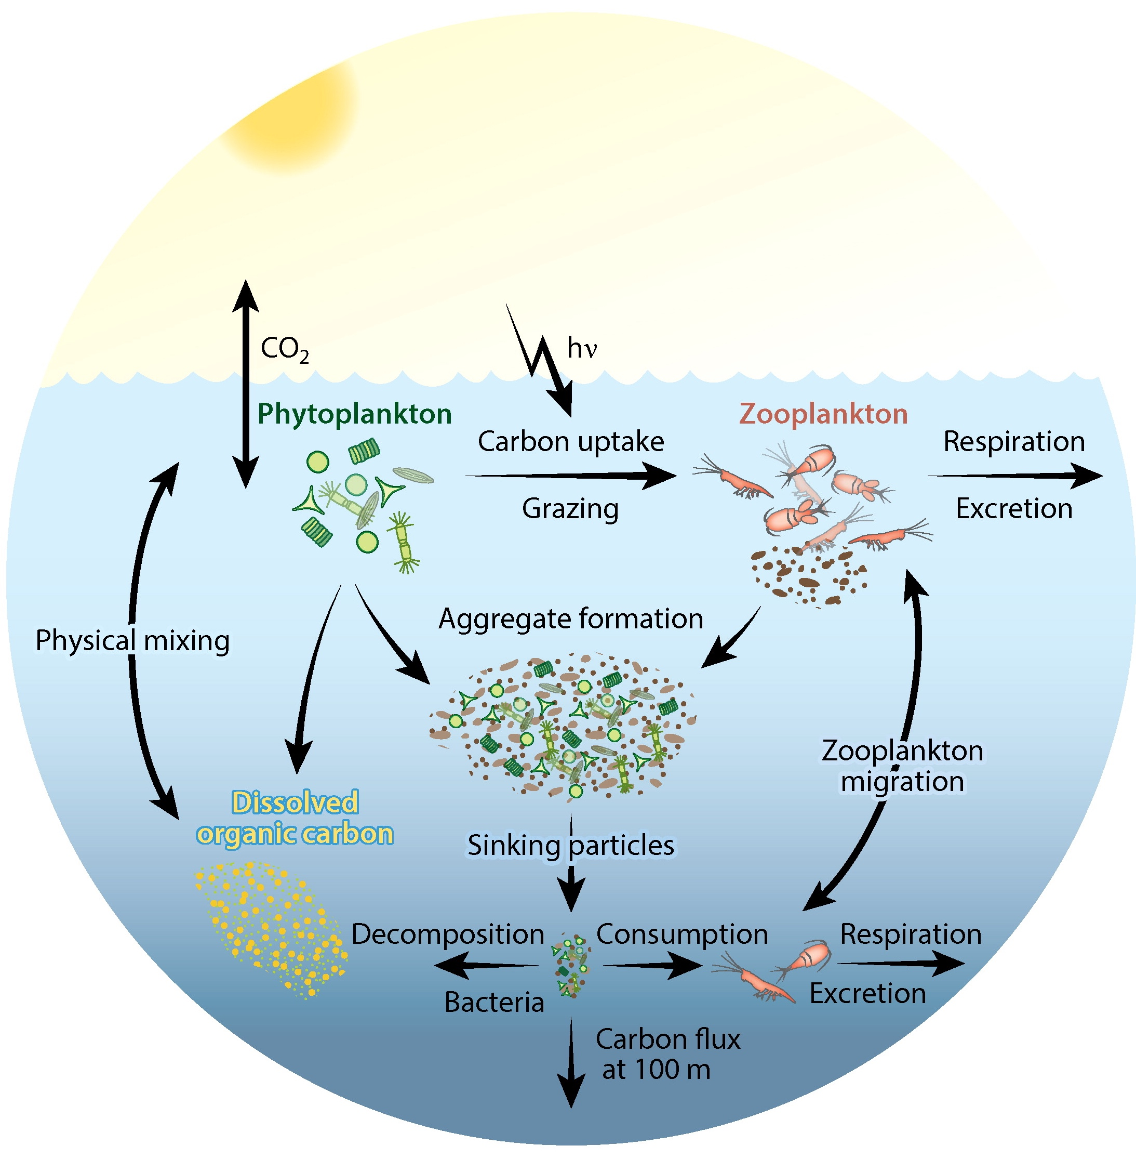
Cycling of marine organic matter

Slide 27
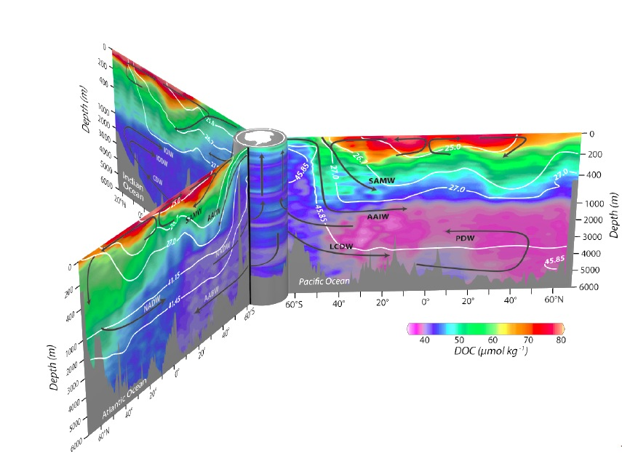
DOC Concentration and Flow Direction
Global DOC Concentrations – there is structure
S.
Ocean
Pacific Ocean
Indian Ocean
Indian
Ocean
Pacific Ocean
P06 2010
A10 2011
N central Pacific (NCP)
Atlantic Ocean
A22 2012
Hansell, Carlson, Repeta and Schlitzer, submitted
Atlantic Ocean
Sargasso Sea (S Sea)
Hansell et al. 2009
Notes:
• There is structure in the [DOC] as shown by Hansell et al.
• DOC Is highest in the subtropical surface waters.
DOC is highest in the deep ocean in the NA where NADW is formed (~ 50 µM), travels south and goes to low 40s, up into the deep Indian (42) and up into the deep Pacific (mid-30s). So there is structure in the DOC concentration that is more intricate than previously believed.

Slide 28
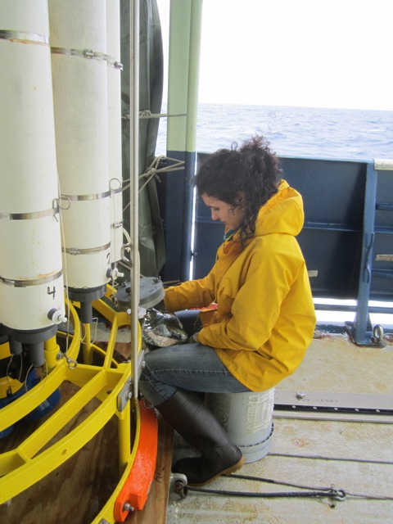
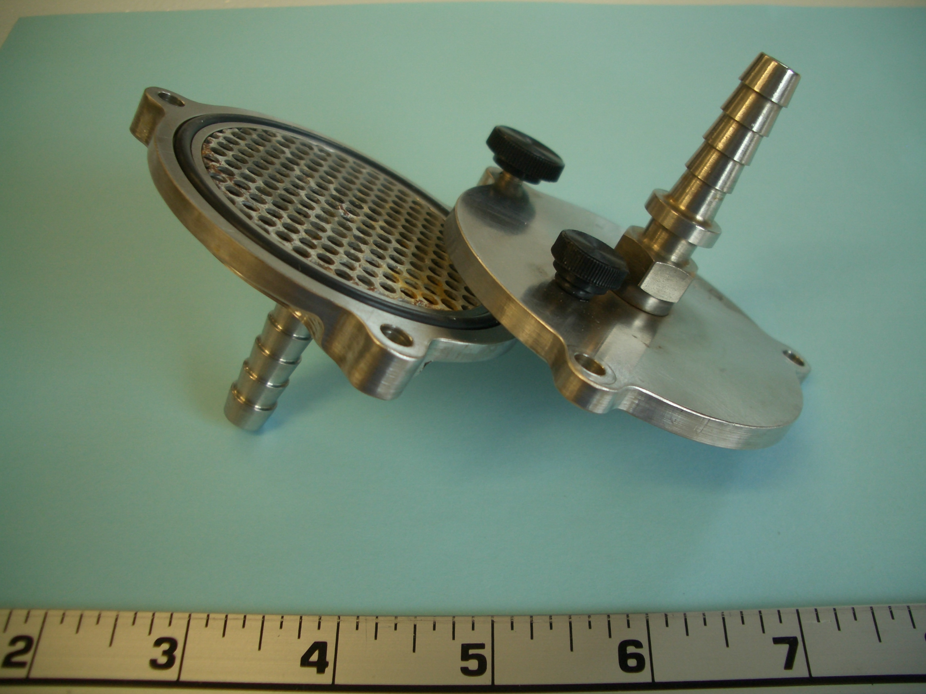
DOC and DIC collection
Water Filtered above 400m
DOC is frozen
DIC is poisoned with HgCl₂
inches
Awesome mini, stainless steel filter holder designed by Sheila Griffin
Alysha Coppola filtering seawater
Notes:
• DOC and DIC are collected using Niskin bottles or Go-flo bottles
• DOC are frozen for 14C analysis back at the lab.
• DIC are poisoned and stored at room temp until we strip them

Slide 29
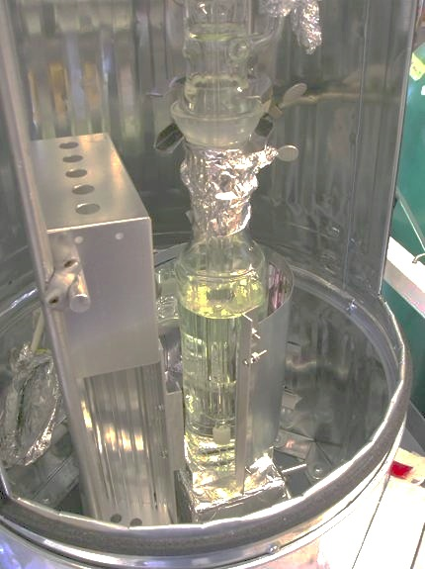
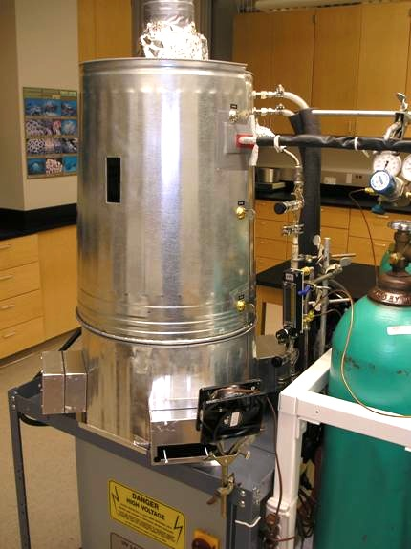
UV Hg-arc lamp, Quartz reactor in…
The Can

Slide 30
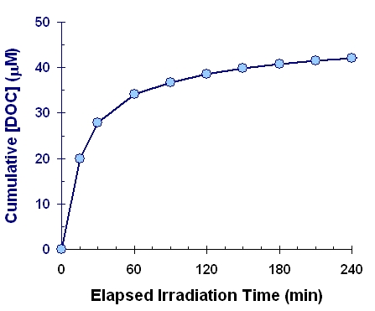
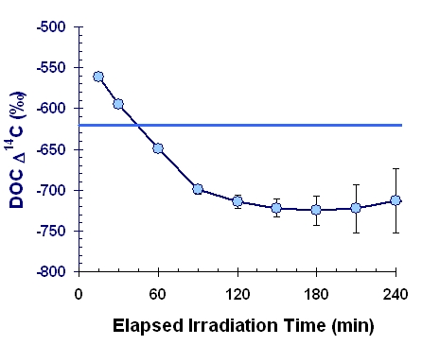
Deep NE Pacific –
Sequential Oxidation of a Single Seawater Sample
6,500 ¹⁴C y
10,000 ¹⁴C y
DOC is a mixture of young and old OC
Beaupré et al 2007

Slide 31
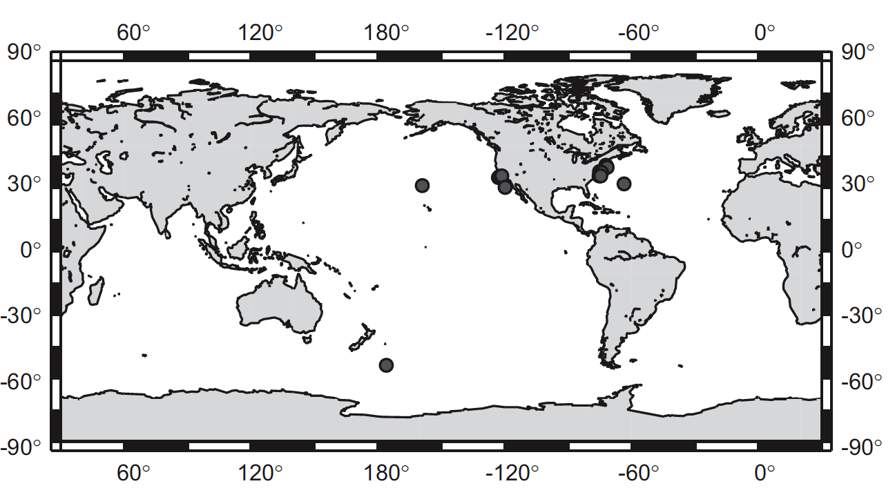
Published DO¹⁴C stations before 2012

Slide 32
Current DO¹⁴C stations + emerging data
Healy
+
+
Oden
+
+
+
x
x
+
A16N
x
+
+
x
+
+
+
NCP
Stn M
x
S. Sea
x
A22
x
x
+
x
P16N
x
x
x
x
x
x
I09N
x
x
x
+
x
+
+
+
+
x
+
+
+
+
I07N
x
P6
x
x
I08S
A10
x
P18
S. Ocean
x

Slide 33
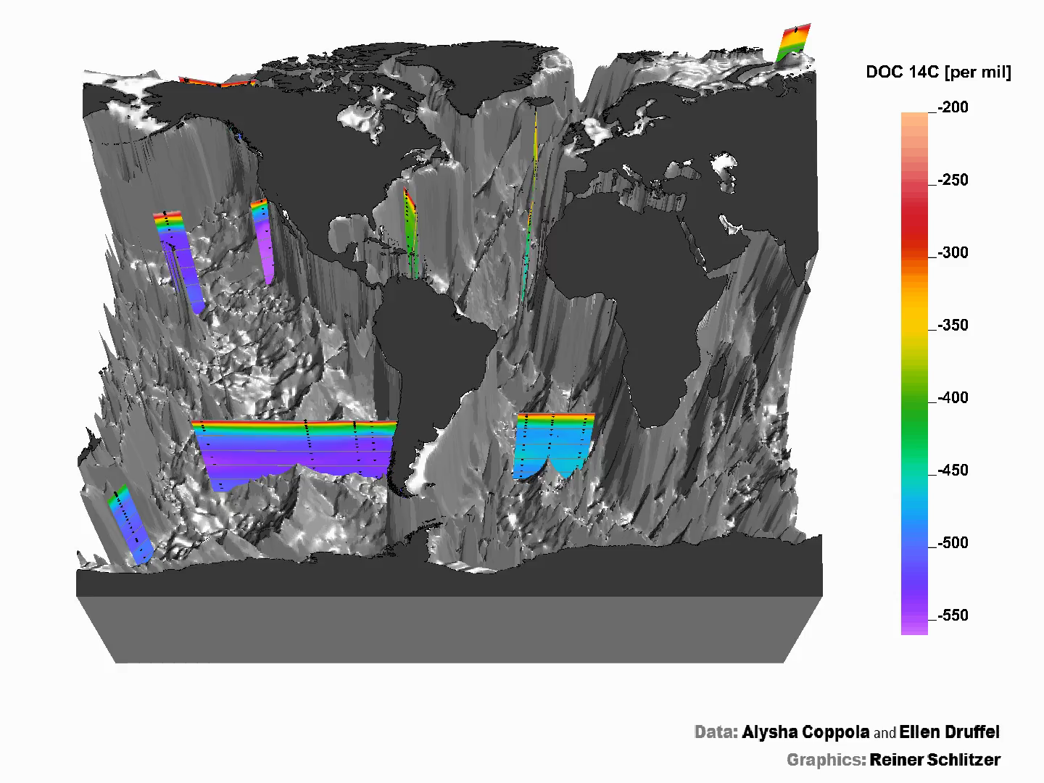
Spatial Distribution of DO¹⁴C in the Ocean
Druffel et al, GRL 2016
Notes:
2015 Druffel and Griffin – All Pacific DO14C = the same. 1987 vs. S. Pac. 2010.

Slide 34
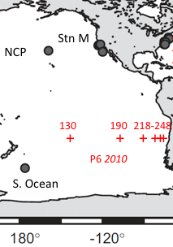
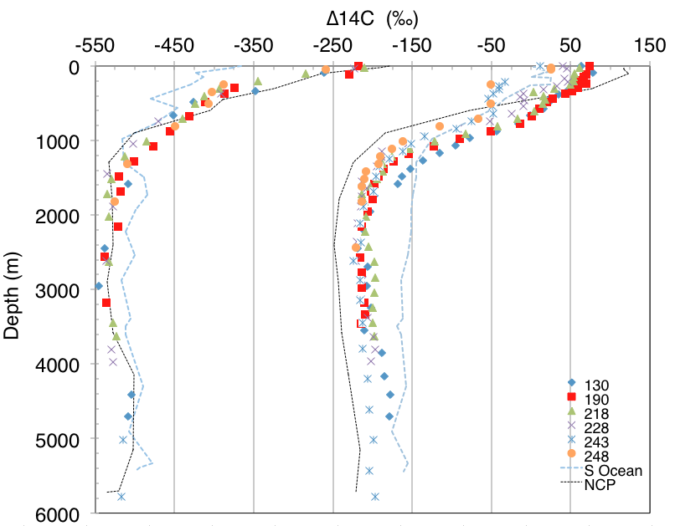
Pacific DOC ∆¹⁴C
Druffel &
Griffin 2015
No difference
30‰ difference

Slide 35
Now see difference in Deep N and S Pacific DOC ∆¹⁴C
Deep DOC ∆¹⁴C has decreased by 23 ± 7‰ over the last 30 years
No change in [DOC] concentrations
Possible Explanations: – 1985/1987 results inaccurate
– Spatial heterogeneity deep DOC ∆¹⁴C
– Temporal change in DOC ∆¹⁴C
– Change in deep circulation?
– Input of ancient hydrothermal DOC?
Temporal changes in DOC ∆¹⁴C is possible – part of deep DOC is of bomb origin (~5%), turned over quickly.
Average difference 23‰

Slide 36
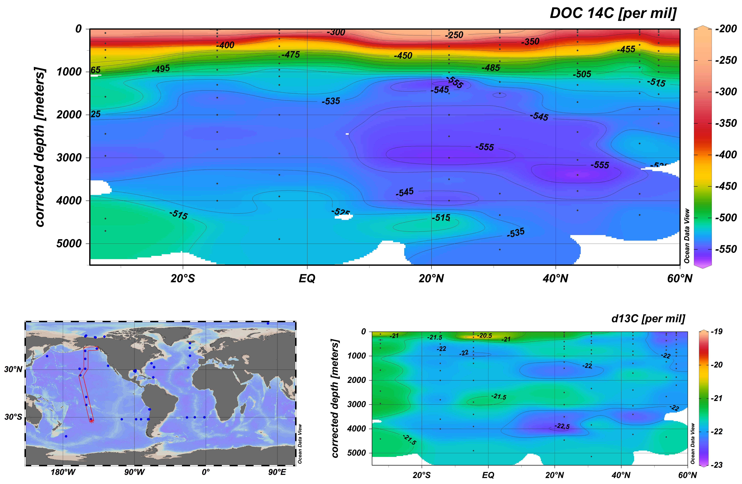
New Deep Pacific DOC ∆¹⁴C
P06
P16N ➞
ALOHA

Slide 37
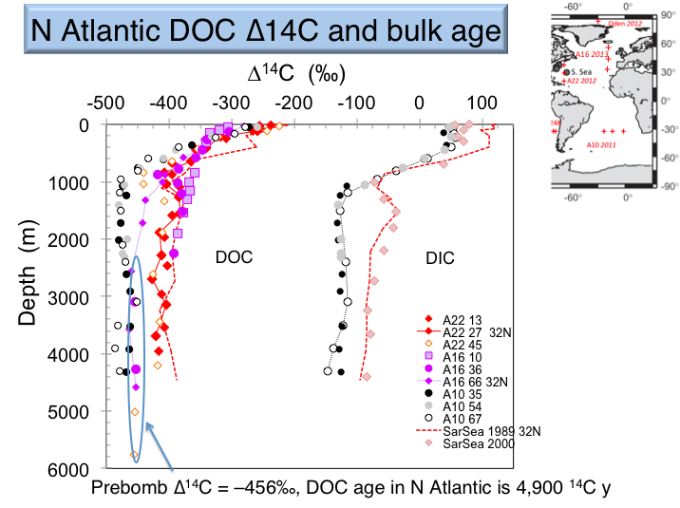
N Atlantic DOC ∆¹⁴C

Slide 38
Estimate of the amount of bomb ¹⁴C in deep N Atlantic DOC
Check yourself
If the ∆¹⁴C of deep DOC in the N Atlantic is -417‰, the pre-bomb DOC was -456‰, and surface DOC was +75, how much post-bomb DOC is there in the deep N. Atlantic?
a) 4%
b) 1%
c) 8%
d) 25%

Slide 39
Estimate of the amount of bomb ¹⁴C in deep N Atlantic DOC
Check yourself
If the ∆¹⁴C of deep DOC in the N Atlantic is -417‰, the pre-bomb DOC was -456‰, and surface DOC was +75, how much post-bomb DOC is there in the deep N. Atlantic?
a) 4%
b) 1%
c) 8%
d) 25%
-417‰= -456(0.92) + 75(0.08)

Slide 40
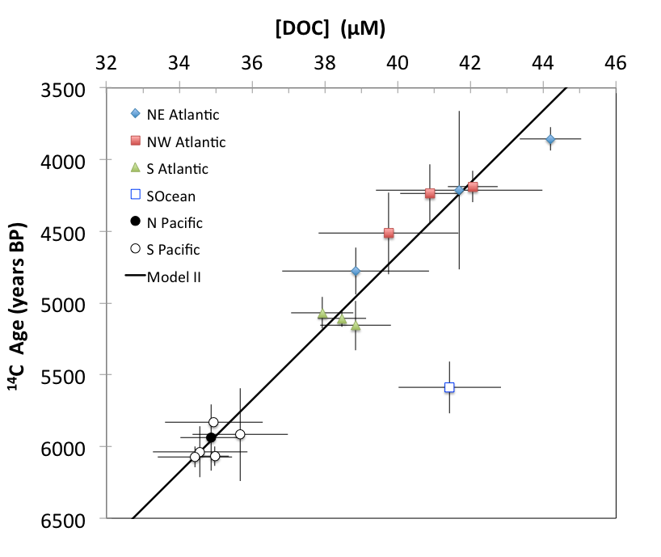
Physics plays a large role in [DOC] & Δ¹⁴C Age
Except for the
S Ocean

Slide 41
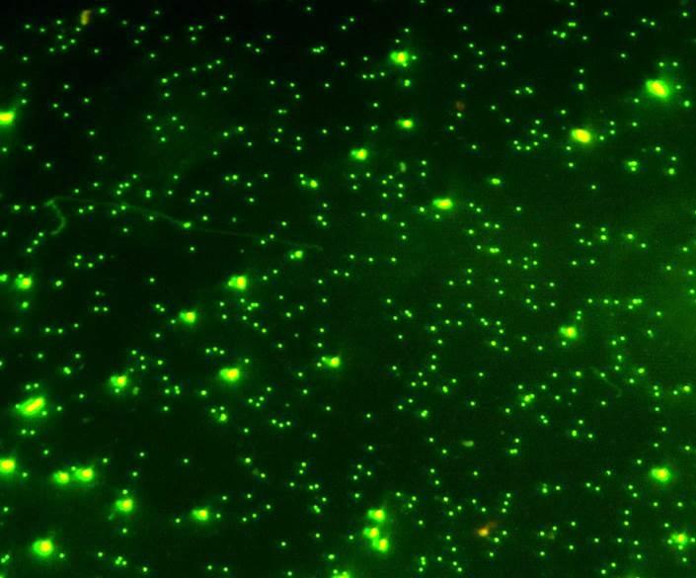
Microbes also play a central role…

Slide 42
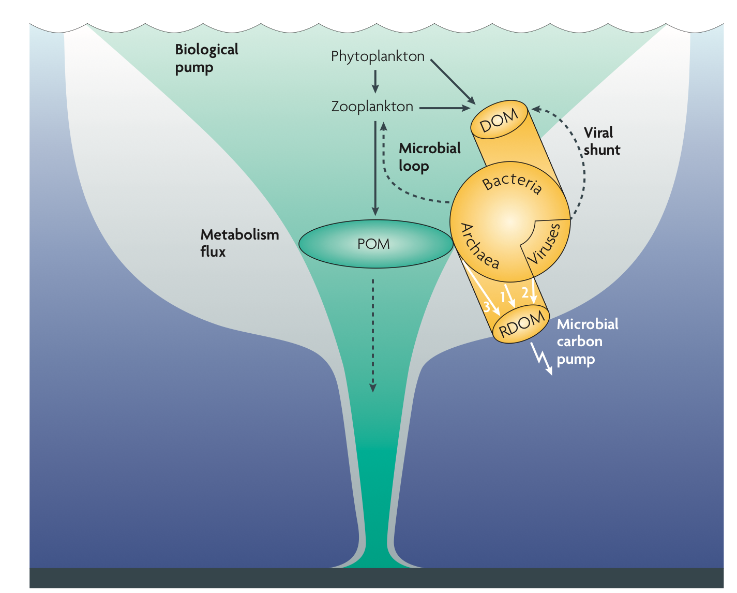
Jiao et al, 2010

Slide 43
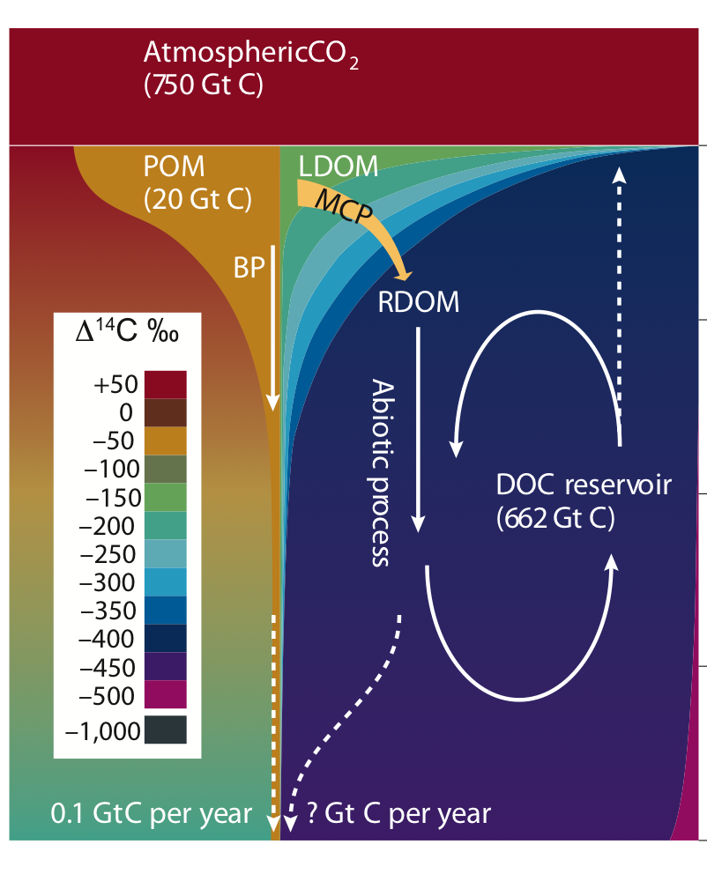
Jiao et al, 2010

Slide 44
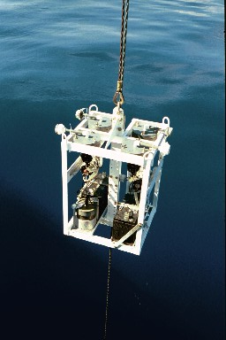
Particulate Organic C (POC)
> 0.2 µm
- Includes:
• fecal pellets, forams, small organisms, marine snow, clay, silt
POC can sink rapidly! (>50µm)
or not!
(<50µm)
.05-5 µM C in seawater
Sinking POC
Suspended POC

Slide 45
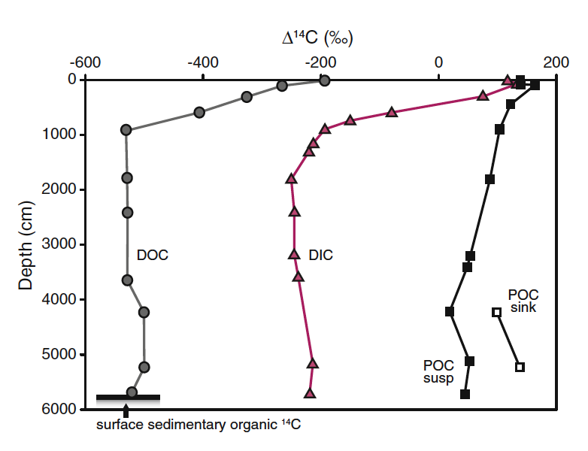
Suspended POC ∆¹⁴C - N Pacific
• Younger than
DIC and DOC
• Hwang et al (2011) observed a linear correlation between ∆¹⁴C and [Al], indicating old, resuspended sediment is making POC old.

Slide 46
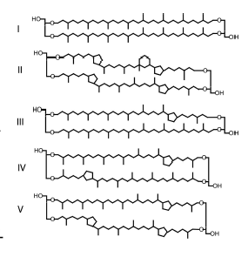
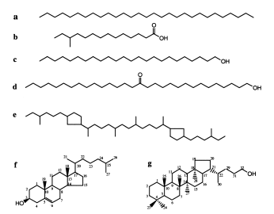
Compound specific radiocarbon analyses (CSRA) Lipids studied by Pearson et al (2001) in sediments and Ingalls et al (2006) in Archaea
N-alkane
C_{15:0} fatty acid
C30 -alkan-15-one-1-ol
Archaeal C40 isoprenoid
Archael lipids
Glycerol dialkyl glycerol tetraether lipids
(GDGTs)
cholesterol
hopanol
Notes:
GDG tetraethers: Glycerol dialkyl glycerol tetraether lipids, present widely in the ocean and on land, unlike what was previously believed that these compounds were restricted to extreme environments.

Slide 47
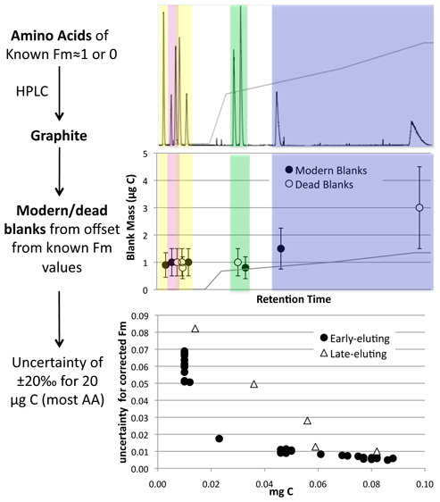
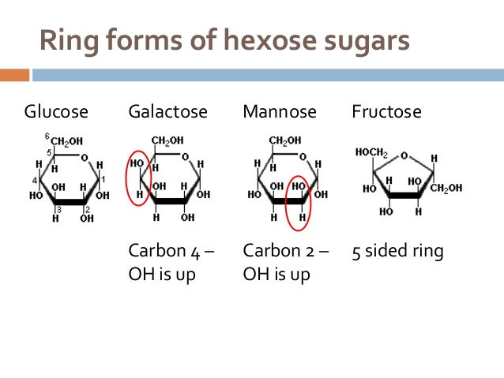
Compound specific radiocarbon analyses (CSRA)
Amino Acids: Bour et al (2016)
Neutral Sugars: Repeta et al (2006)
Hawaii Sugars
15m: +40-60‰ (like DIC) 670m: -100‰ (still bomb ¹⁴C!)

Slide 48
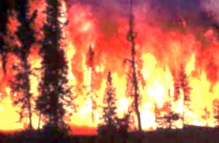
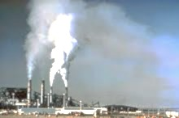
Why is DOC So Old? Is BC important?
Marine Black C (BC) is ~ 5% of DOC and can be
> 23,000 ¹⁴C yr old (–940‰)
BC contributes in a small way to the old ¹⁴C age of DOC
Black Carbon?
Biomass Fossil fuel
burning combustion

Slide 49
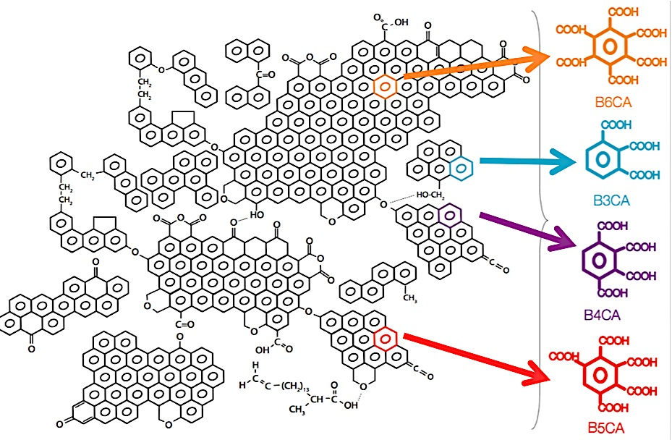
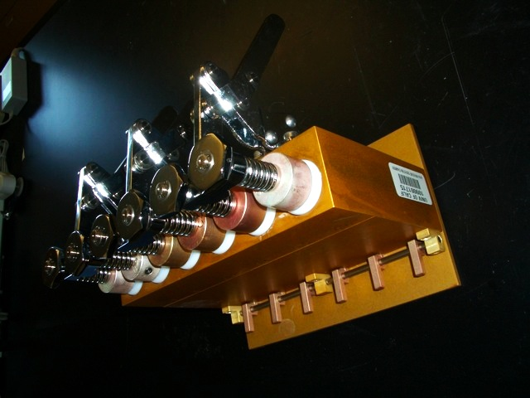
Extracting BC from Seawater
B6CA
B3CA
Derivatized BPCA
Oxidation bomb
B4CA
B5CA
(Goldberg, 1985)
• Oxidize BC to BPCA marker compounds
• Methylate BPCAs for collection on PCGC for ¹⁴C analysis
Notes:
Take photographs for a flow chart

Slide 50
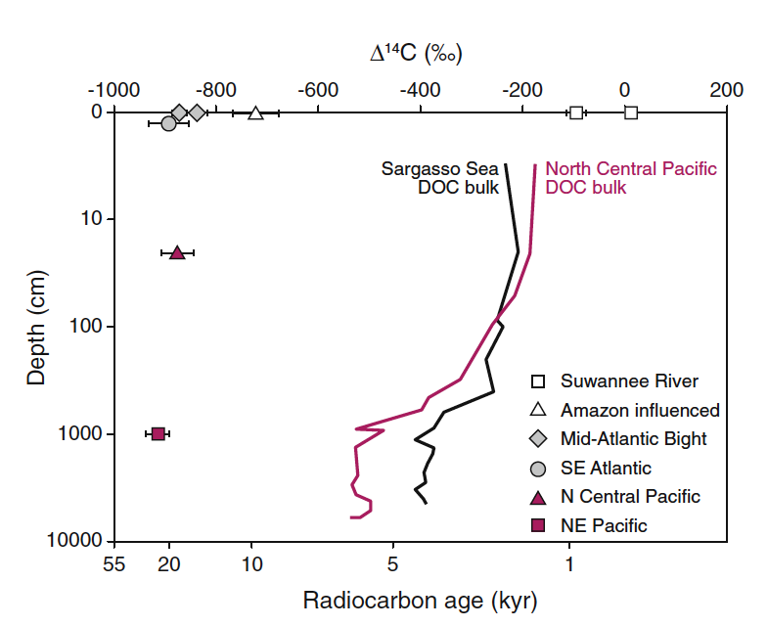
Δ¹⁴C of bulk DOC vs. Δ¹⁴C of BC in SOC
Ziolkowski &
Druffel 2010

Slide 51
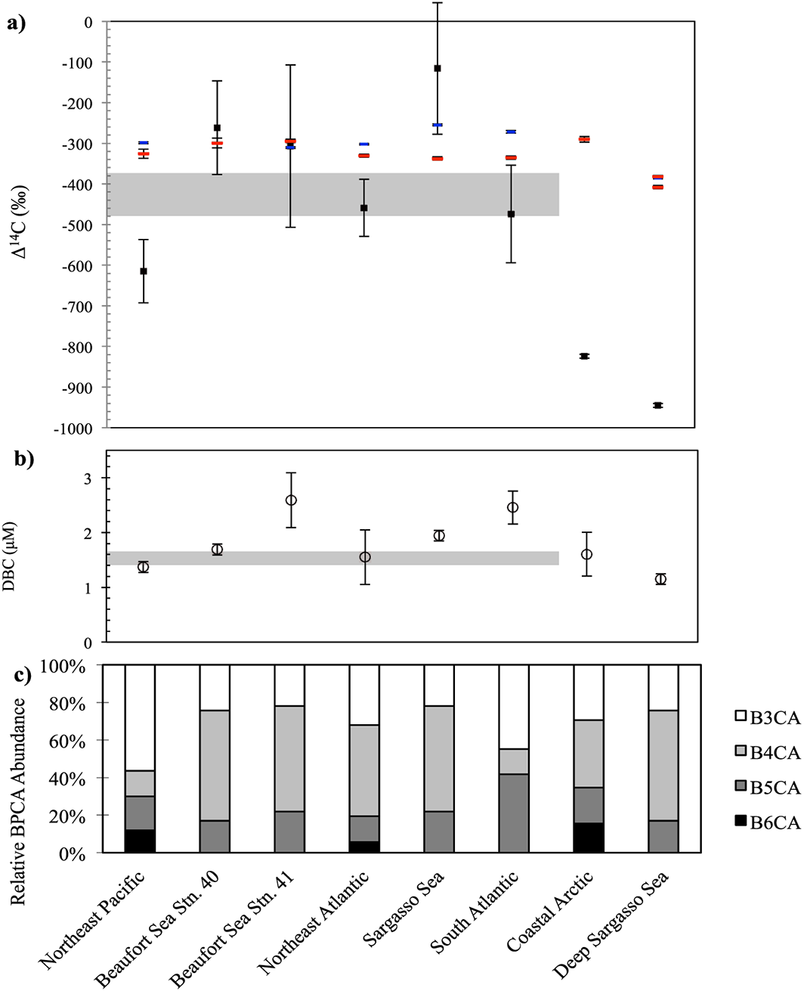
Cycling of BC in the Ocean
Coppola &
Druffel 2016
Notes:
There are 2 groups of points here:
Arctic open ocean and A22 s27, which have BC ∆14C values that are higher than the bulk DOC
All other Atlantic including one deep, and surf Stn M, which have BC ∆14C values that are lower than the bulk DOC.

Slide 52
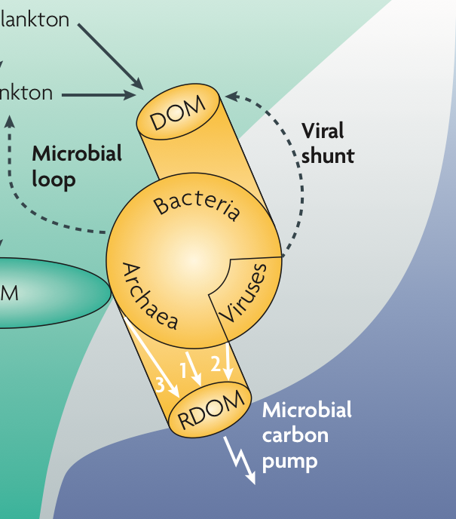
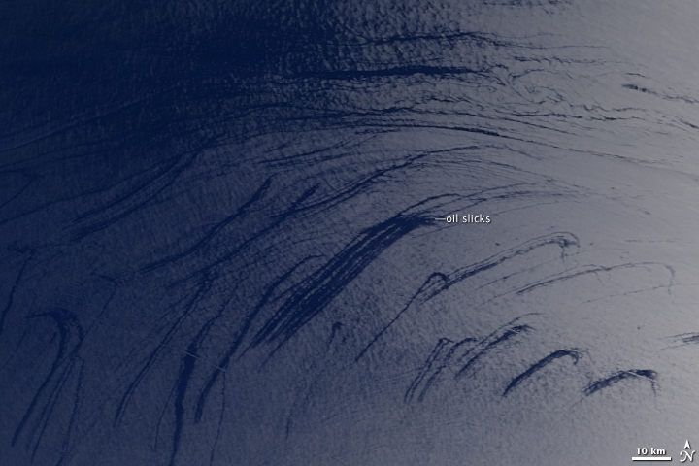
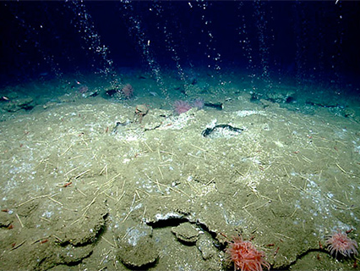
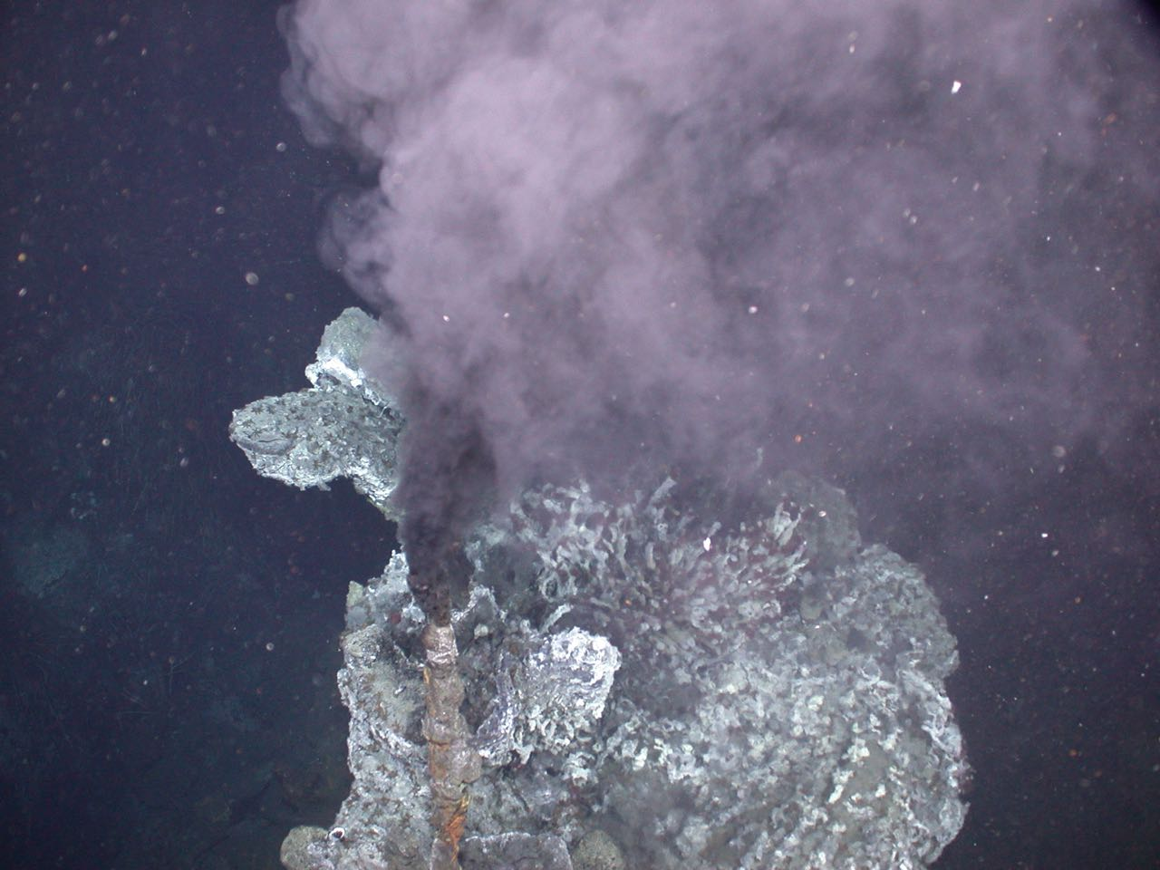
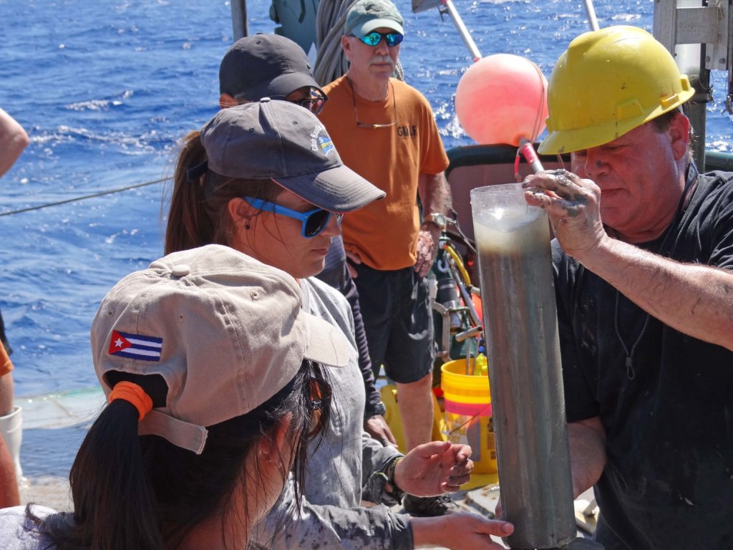
Why is DOC So Old?
Oil seeps
Methane seeps
Black Carbon?
Hydrothermal vents
Sediment porewater

Slide 53
Thank you!
Questions?
Thank you

